Slide 1




Course Name: Data Structure and Algorithm Topic: 1-Dimensional Array
B.TECH III Sem CSE
Academic YEAR: 2024-2025
Course code : CSE 2101
Credits : 4
Mode of delivery : OFFLine (Power point presentation)
Faculty : Mr. Satpal Singh Kushwaha
Email-id : satpal.singh@jaipur.manipal.edu

Slide 2


Slide 3
Arrays
Array form an important part of almost all programming language.
It provides a powerful feature and can be used as such or can be used to form complex data structures like stack and queue.
An array can be defined as an infinite collection of homogeneous (similar data type) elements.
This means that an array can store either all integer, all floating-point numbers, all characters or any other complex data type but all same type.

Slide 4
Arrays [Cont…)
Arrays are always stored in consecutive memory locations.
An array can store multiple value which can be referenced by a single name unlike a simple variable which store one value at a time. Followed by an index or subscript, specified inside a square bracket.
Array name is a pointer to the first location of the memory block allocation to the name of the array.

Slide 5
Types of Arrays
One-Dimensional Arrays
Multi-Dimensional Arrays

Slide 6
One-Dimensional Array
A one-dimensional array is one in which only one subscript specification is needed to specify a particular element of the array.
One dimensional array can be declared as follows:
Datatype Array_Name [size];
Data type is the type of elements to be stored in the array.
Variable name specifies the name of array, it may be given any name like other simple variable.

Slide 7
Arrays
Array Declaration:
data-type name [size];
where data-type is a valid data type (like int, float, char...)
name is a valid identifier
size specifies how many elements the array has to contain.
size field is always enclosed in square brackets [ ] and takes static values.
For example, an array salary containing 5 elements is declared as follows int salary [5];
Notes:
For example
We define an array named salary to represent a set of salaries of a group of employees.
Now the values or the salaries of employees
can be stored as follows.
salary[0]=10000, salary[1]=15000,
salary[2]=20000, salary[4]=10000,…..etc.
where salary[0], salary[1], salary[2]… etc. respectively represent the salaries of first, second, third employee.
After initializing an array, its elements are counted from left to right. Each element of the array, also called a member of the array, has a specific and constant position. The position of an item is also called its index. The first member of the array, the most left, has an index of 0. The second member of the array has an index of 1. Since each array has a number of items which can be specified as n, the last member of the array has an index of n-1
This is a single-dimension array ie. with one subscript. Eg. data-type name [size]. . The arraySize must be an integer constant greater than zero and type can be any valid C++ data type. For example, to declare a 10-element array called balance of type integer, use this statement: int balance[10];

Slide 8
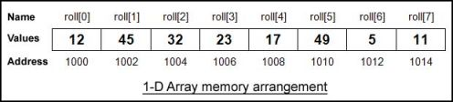
Arrays - One Dimensional
A linear list of fixed number of data items of same type.
These items are accessed using the same name using a single subscript. E.g. roll[0], roll[1]…. or salary [1], salary [4]
A list of items can be given one variable name using only one subscript and such a variable is called a single-subscripted variable or a one- dimensional array.
Notes:
A subscript can be integer constants, Integer variables like i, or expressions that yield integers.
Subscript of subscript is not allowed.
The Maximum subscript value appearing in a program for a subscripted variable should not exceed the declared one.
The subscript value ranges from 0 to one less than the maximum size. For example, If the array size is 5 , then the first subscript is 0, the second is 1 and so on the last subscript is 4. In general i^{th} element has subscript (i-1).

Slide 9
Arrays - 1D
Total size:
The Total memory that can be allocated to 1Darray is computed as
Total size =size *(sizeof (data_type) );
where size→ number of elements in 1-D array
data_type→ basic data type.
sizeof()→ is an unary operator which returns the size of data type in bytes.
Notes:
The sizeof operator yields the size of its operand with respect to the size of type . When the sizeof operator is applied to an object of type char, it yields 1. When the sizeof operator is applied to an array, it yields the total number of bytes in that array. One of the advantages of the sizeof operator used to get the number of members of the array and it can be used on a for loop to scan an array, either to locate the members or to look for a value in the array.

Slide 10
Initializing one-dimensional array
int number[3] ={0,0,0}; or {0} ;
→ declares the variable number as an array of size 3 and will assign 0 to each element.
int age[ ] ={16,25,32,48,52,65};
→ declares the age array to contain 6 elements with initial values 16, 25, 32, 48, 52, 65 respectively

Slide 11
Initialize all the elements of an integer array ‘values’ to zero
Initializing one-dimensional array with zeros
int values[20];
Begin for loop
i<20;
int i=0;
for ( )
i++
Initialize counter
Set limit for counter
Increment counter
Initialize element in array ‘values’
values[i]=0;

Slide 12
Printing one-dimensional array
For example
int x[3] = {9,11,13};
printf(“%d\n”,x[0]);
printf(“%d\n”,x[1]);
printf(“%d\n”,x[2]);
Output:
9
11
13
or
int x[3] = {9,11,13};
for (int i = 0; i<3; i++)
printf(“%d\n”,x[i]);

Slide 13
Program to read n elements into an array and print it
int a[10], i, n;
printf("enter count of numbers“);
scanf(“%d”,&n);
printf(“enter n numbers \n”);
for(i=0;i<n;i++)
scanf(“%d\n”,&a[i]);
printf(“\nNumbers entered are:\n”);
for(i=0;i<n;i++)
printf(“%d\n”,a[i]);
Output:
enter no of numbers
3
enter n numbers
9
11
13
Numbers entered are:
9
11
13

Slide 14
Displaying elements of an array in reverse order.
int a[10], n, i;
printf(“Enter values\n“);
for(i=0;i<n;i++)
scanf(“%d”,&a[i]);
printf(“\nReverse order printing
of array\n”);
for(i=n-1;i>=0;i--) // reverse loop
printf(“%d\n”,a[i]);
Example : a[ ]={1, 2, 3, 4, 5}
Enter values
n=5
1 2 3 4 5
Reverse printing of array
5 4 3 2 1
Array before Array after
a[0]=1 a[0]=1
a[1]=2 a[1]=2
a[2]=3 a[2]=3
a[3]=4 a[3]=4
a[4]=5 a[4]=5

Slide 15
Program to add two array elements and store the corresponding elements sum in another array
int a[10], b[10], c[10],n, m, i;
printf("enter no. of elements in
first array\n“);
scanf(“%d”,&n);
//first array
for(i=0;i<n;i++)
scanf(“%d”,&a[i]);
printf("enter no of elements in second array\n“);
scanf(“%d”,&m);
for(i=0;i<m;i++) //second array
scanf(“%d”,&b[i]);
if(m==n)
{
for(i=0;i<m;i++)
c[i]=a[i]+b[i];
printf(“Sum of given array
elements\n”);
for(i=0;i<n;i++)
printf(“%d\n”,c[i]);
}
else
printf("cannot add“);
}

Slide 16
WAP to insert an element to an array at a given position
int a[100], n,i, pos,ele;
scanf(“%d”,&n); // number of elements
printf("\nEnter the elements of array:“);
for(i=0;i<n;i++)
scanf(“%d”,&a[i]);
printf("\nEnter the element and position of insertion:“);
scanf(“%d %d”,&ele,&pos);
for(i=n; i>=pos; i--) //shift the elements to right
a[i]=a[i-1];
a[pos-1] = ele;//ele is inserted at the specified pos.
n = n + 1; // increment the count of no of elements
printf("\nThe array after insertion is:“);
for(i=0;i<n; i++) printf(“%d\n”,a[i]);
Example : insert 9 at 2nd position
a[ ]={1, 2, 3, 4, 5}
New array after inserting 9 :
a[ ]={1, 9, 2, 3, 4, 5}

Slide 17
WAP to delete an element from an array
printf("enter no of elements in array“);
scanf(“%d”,&n);
printf("enter n elements \n“);
for(i=0;i<n;i++)
scanf(“%d”,&a[i]);
printf("enter the position at which the element to be deleted“);
scanf(“%d”,&pos);
for(i=pos-1; i<n-1; i++)
a[i] =a[i+1]; //shift the elements to left
n = n-1; //decrement the count of no of elements
for(i=0;i<n;i++)
printf(“%d”,a[i]);
Example : delete ele at 2nd position
a[ ]={1, 2, 3, 4, 5}
New array after deleting 2:
a[ ]={1, 3, 4, 5}

Slide 18
Insert an element into a sorted array
Read array elements (in sorted order) & element ‘ele’ to be inserted
Example: insert 3 into the array
a[ ] = {1, 2, 4, 5,6}
//finding position
for(i=0;i<n;i++)
if (ele<a[i]) break;
pos = i+1; //position of insertion
for(i=n; i>=pos; i--) //shift the elements to right
a[i]=a[i-1];
a[pos-1] = ele;//ele is inserted at the specified pos.
n = n + 1; // increment the count of no of elements
New array after inserting 3 :
a[ ] = {1, 2, 3, 4, 5,6}

Slide 19
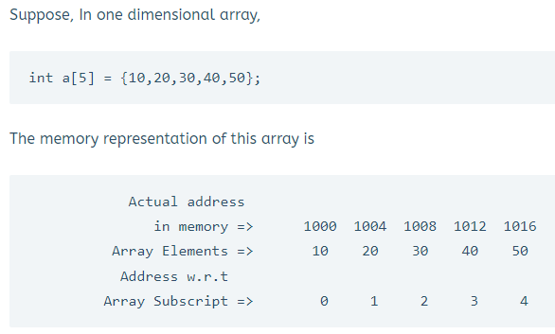
Address Calculation

Slide 20
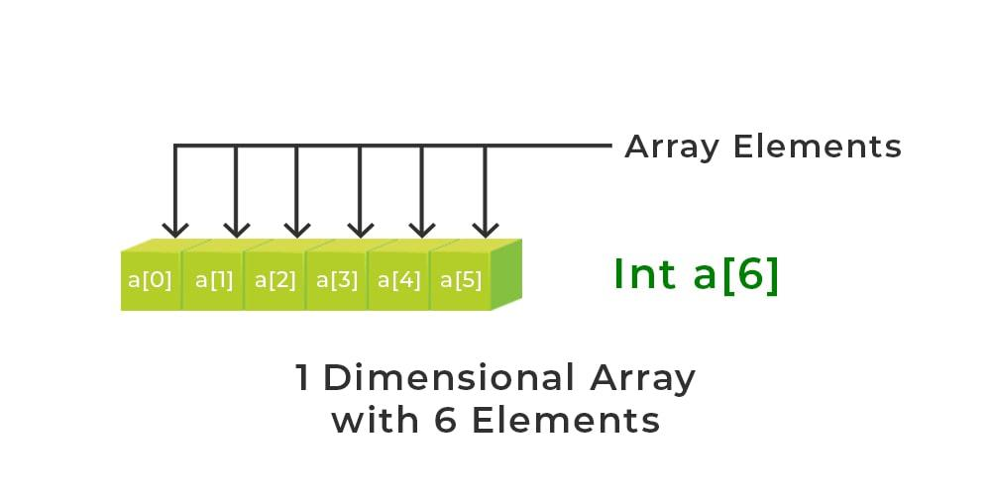
Address Calculation
Address of A[I] = B + W * (I – LB)
I = Index of element whose address to be found,
B = Base address,
W = Storage size of one element store in any array(in byte),
LB = Lower Limit/Lower Bound of subscript(If not specified assume zero).

Slide 21
Address Calculation
Example: Given the base address of an array A[1300 ………… 1900] as 1020 and the size of each element is 2 bytes in the memory, find the address of A[1700].
Solution:
Given: Base address B = 1020 Lower Limit/Lower Bound of subscript LB = 1300 Storage size of one element store in any array W = 2 Byte Index of element whose address to be found I = 1700
Formula used: Address of A[I] = B + W * (I – LB)
Solution: Address of A[1700] = 1020 + 2 * (1700 – 1300) = 1020 + 2 * (400) = 1020 + 800 Address of A[1700] = 1820

